Slide 1

SHERPA CRM

Slide 2
What is a CRM?
Manages customer interactions.
Drive sales
Store customer data in a central database.

Slide 3
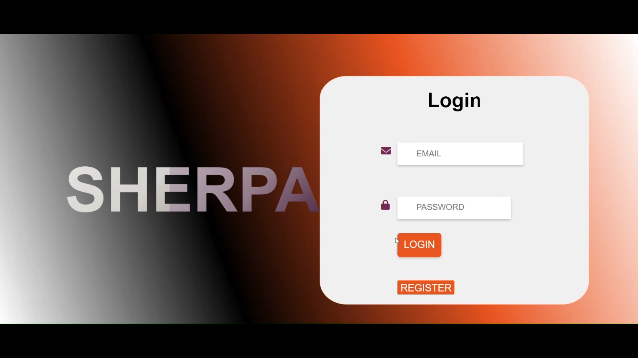
What can Sherpa do?
Software as a Service (SaaS) platform.
Customer database.
Customer interaction using Google API integrations.
Data driven decisions.

Slide 4
How did we make it?
Flask application
MySQL Database

Slide 5
SaaS through a “Teams” based model
Users need to be a member of a Sherpa team.
Invite colleagues to join your team via Email (SMTP).
Login using the invite link (Secrets module).
Business data is segregated (Team IDs).

Slide 6
Contacts and deals database
What is a contact?
Potential or existing customer.
What is a deal?
Potential or existing sales contract.
Deals can be “open” or “closed”.
Technically deals and contacts are quite similar.

Slide 7
Filtering the database
Admins can assign team members to specific contacts or deals.
You can click a button to filter the DB for just your contacts.

Slide 8
Searching the database
You can search for a particular name, email, phone number etc.
Optimized with regex.

Slide 9
Sorting the database
Sort by any column in the contacts or deals page.
Sort in ascending order or descending order with “toggle” buttons.

Slide 10
Database paging
Just 25 rows per page for the databases.
Use “next page” or “previous page” to navigate records.

Slide 11
Customer Interactions & Google API Integrations
What is OAuth ( open authorization )?
Authorize and access user resources to a third party service.
You give Sherpa delegated access to Google account resources.
Only works for whitelisted Google accounts.
Brought to Google login splash screen.

Slide 12
Google Meets Integration
You can schedule meetings.
Uses HTML5 datetime selection widget.
Any meetings scheduled with contact appear.
You can join meeting right from Sherpa.
Also appears in both your calendars.

Slide 13
Google Tasks Integration
Create tasks that appear in your calendar.
Any tasks for that contact appear on page.
You can mark tasks as complete.
Sorted by upcoming, past due, and completed.

Slide 14
Gmail Integration
Can send emails from google account to contact’s inbox.
Any emails you exchange appear in Sherpa.
Can easily reply to threads.

Slide 15
Notes Feature
Facilitates collaboration.

Slide 16
“Activity” Feature
oAuth interactions are opaque.
The activity function tracks the metadata of activities.
Useful for analytics and collaboration.

Slide 17
API Integration Technical Challenges
We were completely new to oAuth.
Each Google API had its quirks.
Required extensive parsing.

Slide 18
Data Analytics
Sherpa home includes an analytics dashboard made with Pandas.
Sherpa supports 4 graphs.

Slide 19
What we didn’t have time to talk about
An extensive test suite using PyTest.
Native app-like performance using Turbo.
Modular application using Flask blueprints.
CSS (animations etc).

Slide 20
Why Sherpa? Why not just Gmail etc?
Everyone on your team has a cohesive view.
It makes management easier.
Everything is traceable.

